Slide 1

US Homicides 2000-2014
Brittany Alvaro
Kenny Cutler
Bamrot Abebe
June 05, 2019

Slide 2

Motivation
Are there trends in homicides occurring in the United States?
Age of the victims by sex
Number of homicides per year
States with the most homicides
Perpetrator weapon of choice
Proportion of crimes solved
Homicide types
Sex of perpetrators
Sex of victims
Cities homicides took place

Slide 3
Perpetrators
Victims
Answers
Weapons
Data source: https://www.kaggle.com Analysis of homicides

Slide 4
Initial
638K records (1980-2014)
236K records (2000-2014)
Clean up
Removed columns
Renamed items
Challenges
Merged too many items causing skew

Slide 5
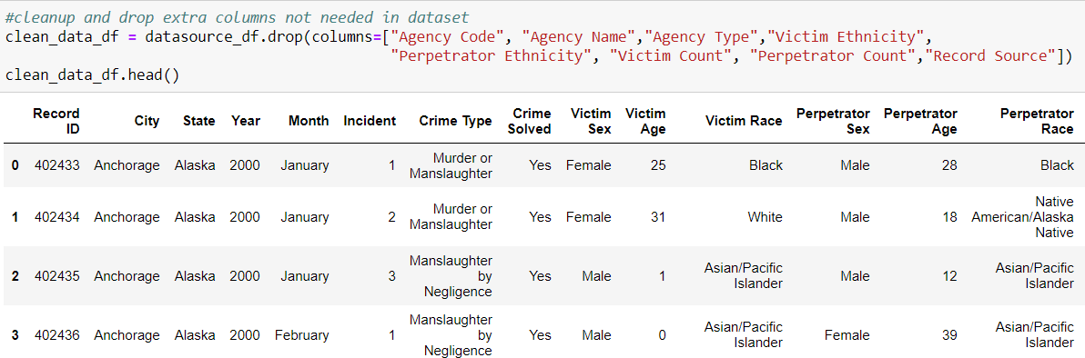
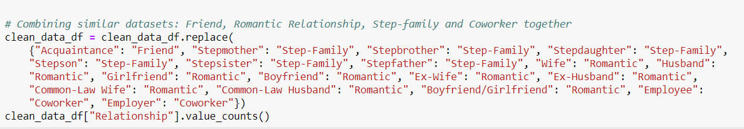

Slide 6
Analysis
Groupby
Merge
Binning
Descriptive statistics

Slide 7
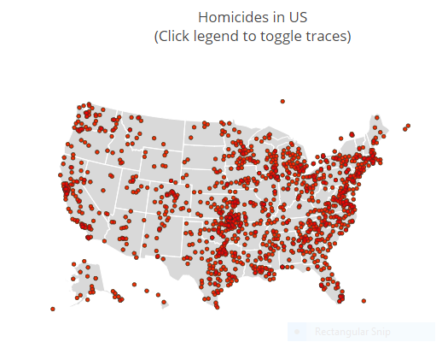

Slide 8
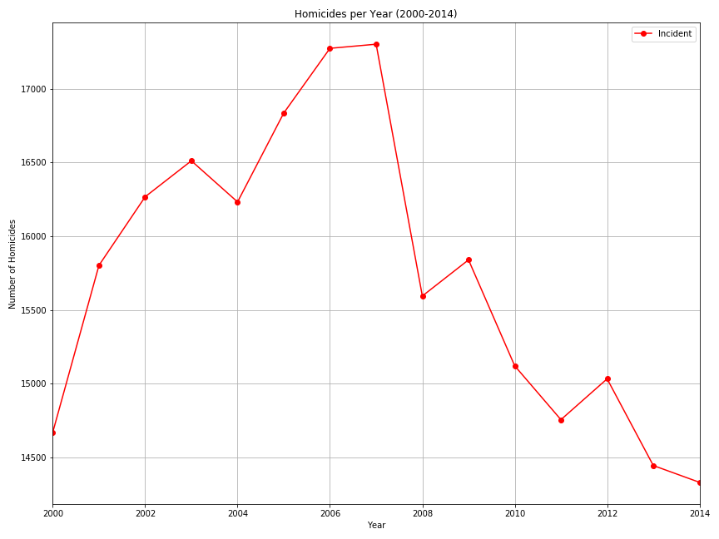

Slide 9
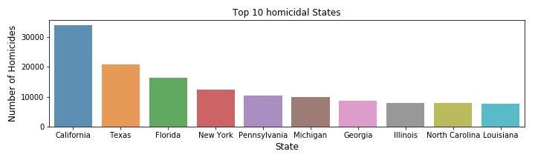

Slide 10
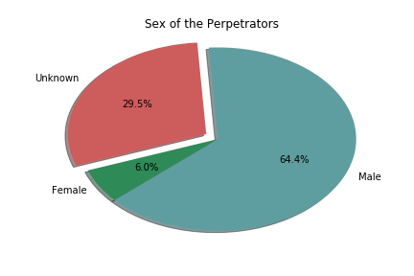
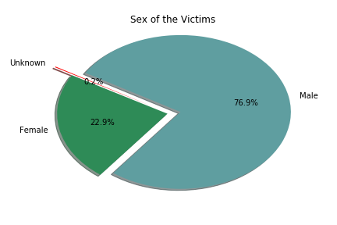

Slide 11
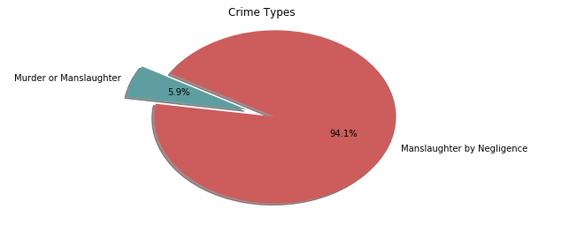
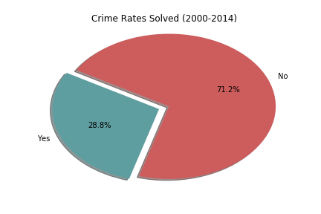

Slide 12
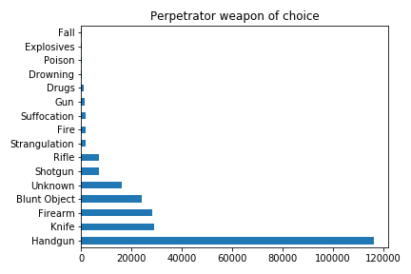

Slide 13
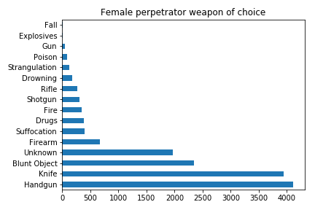
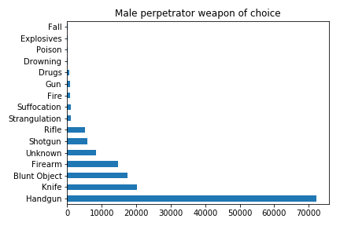

Slide 14
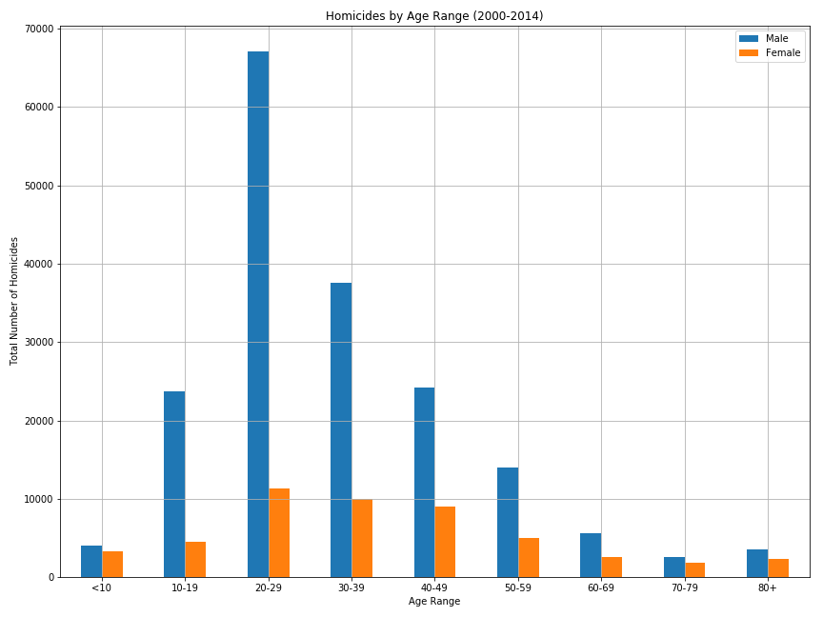

Slide 15
Results
Handguns are the most popular weapon of choice
Majority of the crimes were unsolved
Unexpected result, majority were expected to be solved
Male and female between 20-29 were most common victims
Females between 30-39 and 40-49 not too far behind those between 20-29
Manslaughter by negligence were most common
Unexpected result, expected majority to be murder or manslaughter
California had the highest rate of homicides
Male perpetrators were the most common
Homicides reached peak in 2007
Majority of victims are male

Slide 16
Challenges
Previous topic didn’t lend itself to quality analysis
Quality of data was bad
Possibly too challenging for current skillset
Branching and merging data to master
Ran into a major issue where some files were deleted
Tried a couple bubble plots (scatter plot and bubble map plot)
Data was not sufficient for either
Only one dataset for bubble plot used
Possibilities
Correlation between relationship of victim and perpetrator?
Could we make the bubble plot map?

Slide 17
Questions or Comments

